Slide 1

Relational Algebra
TIF 2302

Slide 2

Learning Objectives
• The meaning of the term “relational completeness.” • How to form queries in the relational algebra.

Slide 3
Relational Operators
Relational algebra and relational calculus are formal languages associated with the relational model.
Informally, relational algebra is a (high-level) procedural language and relational calculus a non-procedural language.
However, formally both are equivalent to one another.
A language that produces a relation that can be derived using relational calculus is relationally complete.

Slide 4
Relational Algebra
Relational algebra operations work on one or more relations to define another relation without changing the original relations.
Both operands and results are relations, so output from one operation can become input to another operation.
Allows expressions to be nested, just as in arithmetic. This property is called closure.

Slide 5
Relational algebra
Relvar: Variable that holds a relation
Heading contains the names of the attributes and the body contains the relation
Relational operators have the property of closure
Closure: Use of relational algebra operators on existing relations produces new relations

Slide 6
Relational Algebra
Five basic operations in relational algebra: Selection, Projection, Cartesian product, Union, and Set Difference.
These perform most of the data retrieval operations needed.
Also have Join, Intersection, and Division operations, which can be expressed in terms of 5 basic operations.

Slide 7
Relational Algebra
The Selection and Projection operations are unary operations, as they operate on one relation.
The other operations work on pairs of relations and are therefore called binary operations.

Slide 8
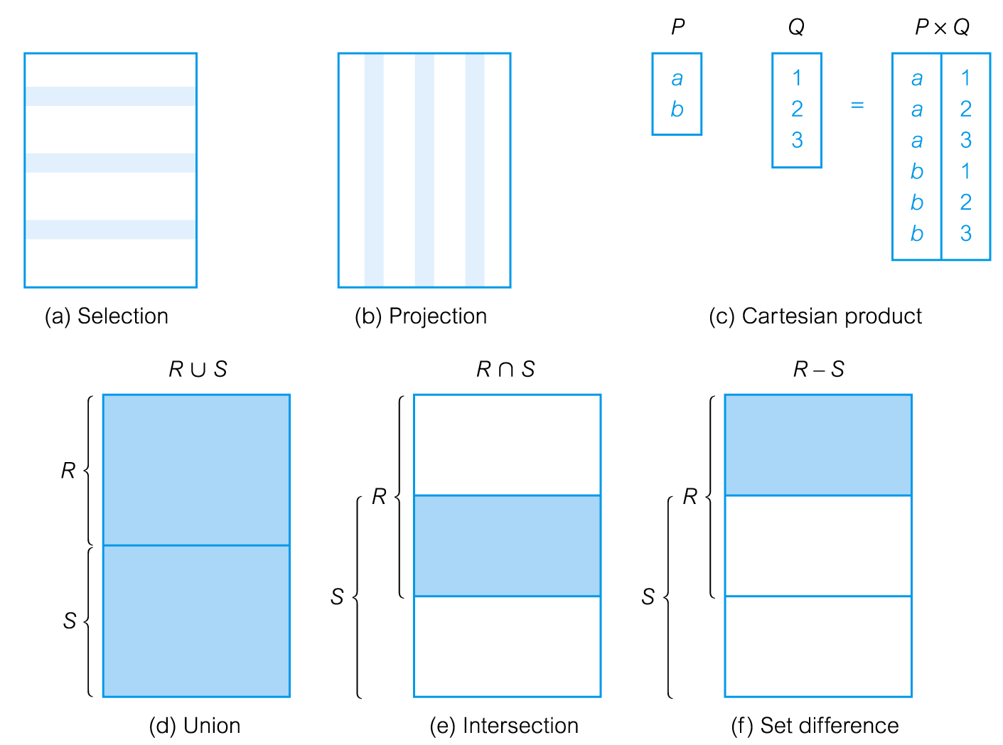
Relational Algebra Operations

Slide 9
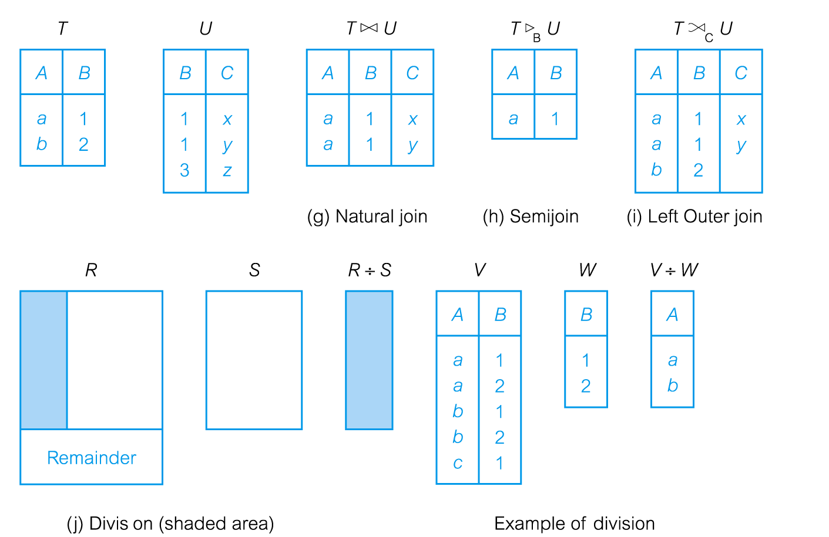
Relational Algebra Operations

Slide 10
Selection (or Restriction)
Works on a single relation R and defines a relation that contains only those tuples (rows) of R that satisfy the specified condition (predicate).

Slide 11
Selection (or Restriction)
Notation:
σ _{p}(r)
σ is called sigma
p is called the selection predicate
Defined as: σ_{p}(r) = {t | t ∈ r and p(t)}
Where p is a formula in propositional calculus consisting of terms connected by : ∧ (and), ∨ (or), ¬ (not)
Each term is one of:
<attribute> op <attribute> or <constant>
where op is one of: =, ≠, >, ≥. <. ≤

Slide 12
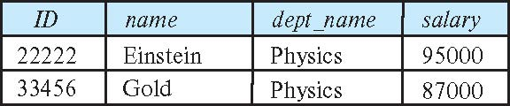
Example (Select)
Select those tuples of the instructor relation where the instructor is in the “Physics” department.
_{dept_name=“Physics”} (instructor)
Result

Slide 13
Example (Select)
List all staff with a salary greater than £10,000.
σsalary > 10000(Staff)
Result

Slide 14
Example (Select)
Find the instructors in Physics with a salary greater $90,000, we write:
σ _{dept_name=“Physics”} ∧ _{salary} > 90,000 (instructor)

Slide 15
Example (Select)
select predicate may include comparisons between two attributes.
find all departments whose name is the same as their building name:
σ _{dept_name=building} (department)

Slide 16
Projection
Works on a single relation R and defines a relation that contains a vertical subset (extracts data vertically ) (i.e. as a column) of R, extracting the values of specified attributes and eliminating duplicates.

Slide 17
Project
Notation:
where A₁, A₂ are attribute names and r is a relation name.
The result is defined as the relation of k columns obtained by erasing the columns that are not listed
Duplicate rows removed from result, since relations are sets

Slide 18
Example (Project)
To eliminate the dept_name attribute of instructor
∏_{ID, name, salary} (instructor)

Slide 19
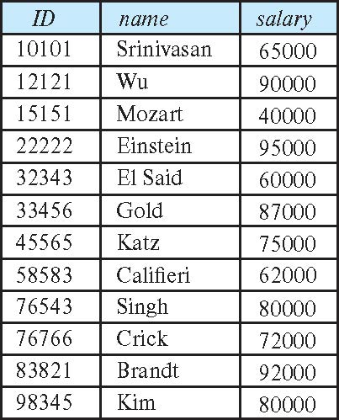
Example (Project)
Result

Slide 20
Example (Project)
Produce a list of salaries for all staff, showing only the staffNo, fName, lName, and salary details.
ΠstaffNo, fName, lName, salary(Staff)
Result

Slide 21
Composition of Relational Operations
The result of a relational-algebra operation is relation and therefore of relational-algebra operations can be composed together into a relational-algebra expression.
Consider the query -- Find the names of all instructors in the Physics department.
∏_{name}(σ _{dept_name} _{=“Physics”} (instructor))
Instead of giving the name of a relation as the argument of the projection operation, we give an expression that evaluates to a relation.

Slide 22
Union
Notation:
r ∪ s
Defined as: r ∪ s = {t | t ∈ r or t ∈ s}
For r ∪ s to be valid.
1. r, s must have the same arity (same number of attributes)
2. The attribute domains must be compatible (example: 2nd column of r deals with the same type of values as does the 2nd column of s)

Slide 23
Union
Binary operator - it takes two relations, r and s, both of which must have the same set of attributes
The union, r ∪ s consists of all the tuples in r and all the tuples in s

Slide 24
Example - Union
Product table 1 ∪ Product table 2

Slide 25
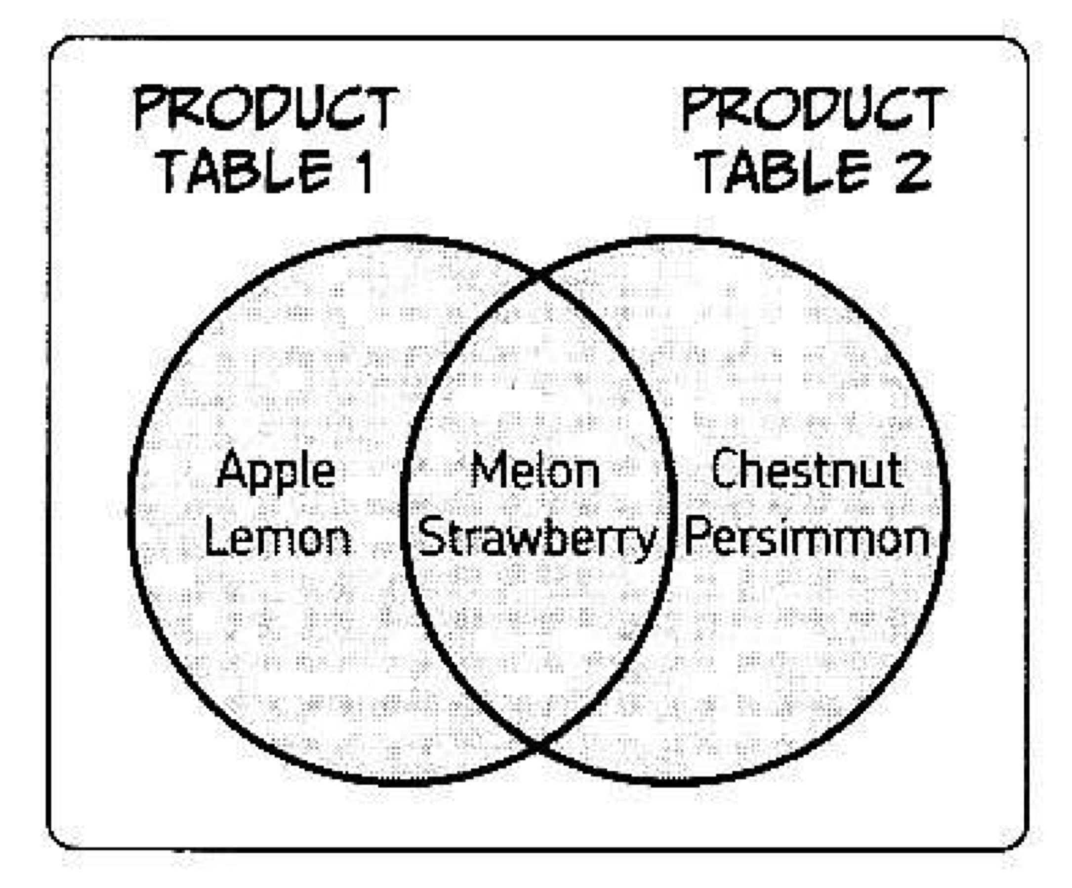
Example – Union

Slide 26
Example - Union

Slide 27
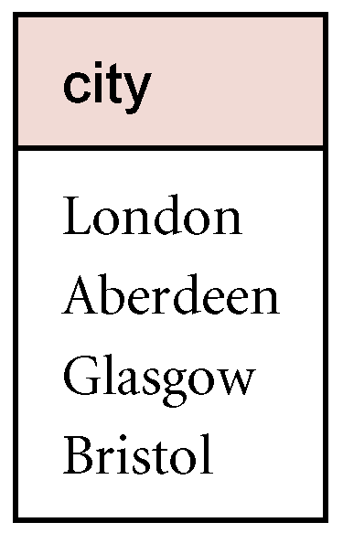
Example - Union
List all cities where there is either a branch office or a property for rent.
Π_{city}(Branch) ∪ Π_{city}(PropertyForRent)
Result

Slide 28
Example - Union
Find all courses taught in the Fall 2017 semester, or in the Spring 2018 semester, or in both ∏_{course_id} (σ _{semester=“Fall” Λ year=2017} (section)) ∪ ∏_{course_id} (σ _{semester=“Spring” Λ year=2018} (section))

Slide 29
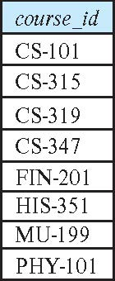
Example - Union
Result of: ∏_{course_id} (σ _{semester=“Fall” Λ year=2017} (section)) ∪ ∏_{course_id} (σ _{semester=“Spring” Λ year=2018} (section))

Slide 30
Set Difference
Defines a relation consisting of the tuples that are in relation R, but not in S.
R and S must be union-compatible. Set differences must be taken between compatible relations.
r and s must have the same arity
attribute domains of r and s must be compatible
Notation
r – s

Slide 31
Example - Set difference
all of the products in the first table that don’t appear in the second.
Product table 1 – Product table 2

Slide 32
Example - Set difference
all of the products in the second table that don’t appear in the first.
Product table 2 – Product table 1

Slide 33
Example - Set difference
List all cities where there is a branch office but no properties for rent.
Πcity(Branch) − Πcity(PropertyForRent)

Slide 34
Intersection
R ∩ S
Defines a relation consisting of the set of all tuples that are in both R and S.
R and S must be union-compatible.
Expressed using basic operations:
R ∩ S = R – (R – S)

Slide 35
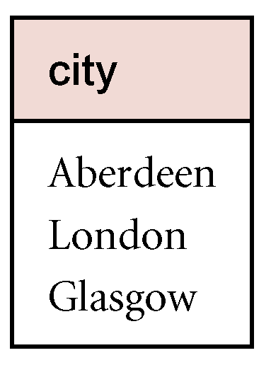
Example - Intersection
List all cities where there is both a branch office and at least one property for rent.
Π_{city}(Branch) ∩ Π_{city}(PropertyForRent)

Slide 36
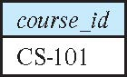
Example - Intersection
Find the set of all courses taught in both the Fall 2017 and the Spring 2018 semesters.
∏_{course_id} (σ _{semester=“Fall” Λ year=2017} (section)) ∩ ∏_{course_id} (σ _{semester=“Spring” Λ year=2018} (section))
Result

Slide 37
Cartesian-Product Operation
R X S
Defines a relation that is the concatenation of every tuple of relation R with every tuple of relation S.
The Cartesian-product operation (denoted by X) allows us to combine information from any two relations.
It is possible that the two relations may have attributes with the same name.
In this case, the attribute names are prefixed with the relation name to maintain the uniqueness of attribute names within a relation.

Slide 38
Example (Cartesian-Product Operation)
the Cartesian product of the relations instructor and teaches is written as:
instructor X teaches
We construct a tuple of the result out of each possible pair of tuples: one from the instructor relation and one from the teaches relation (see next slide)
Since the instructor ID appears in both relations we distinguish between these attribute by attaching to the attribute the name of the relation from which the attribute originally came.
instructor.ID
teaches.ID

Slide 39
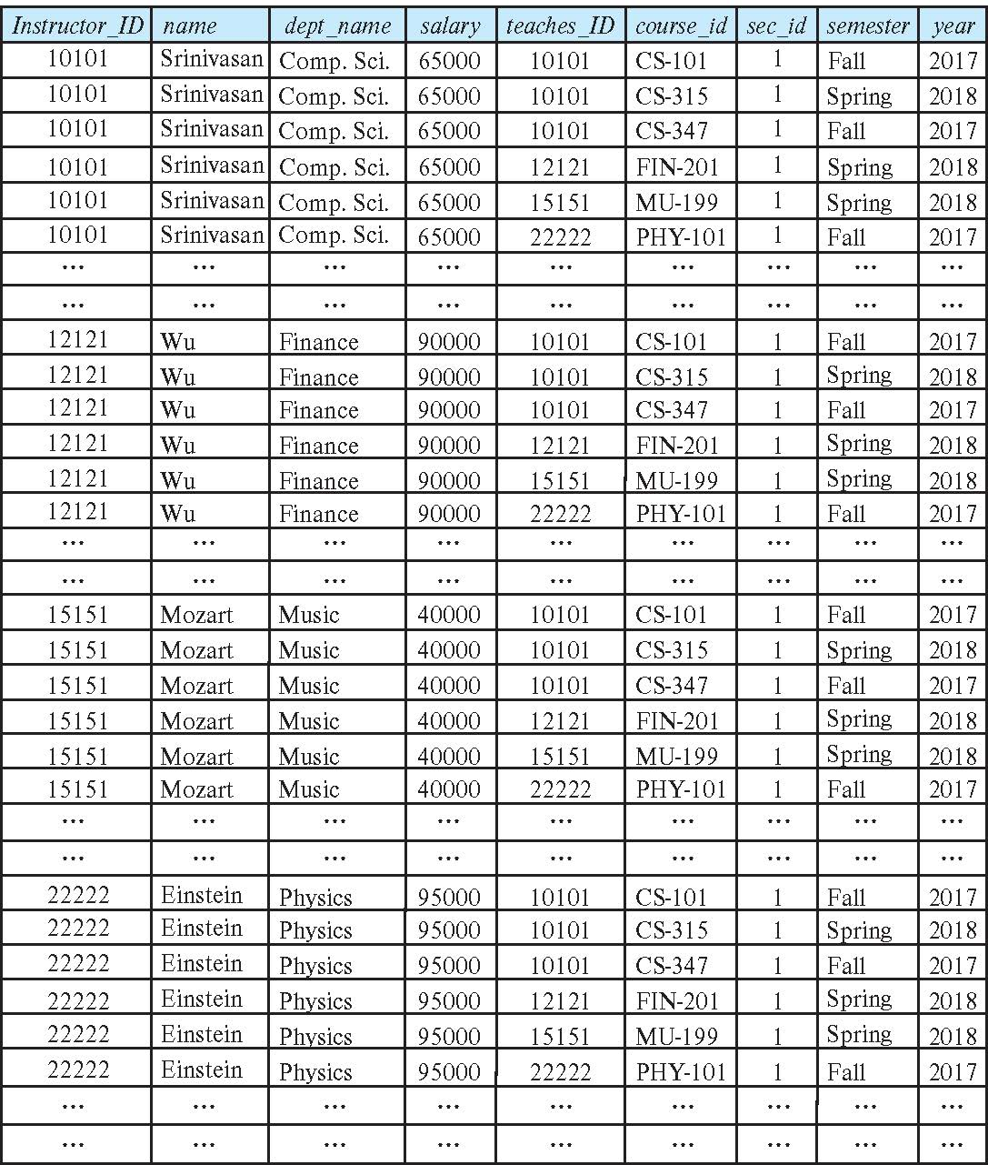
Example (Cartesian-Product Operation)
result

Slide 40
Example (Cartesian-Product Operation)
Combines all rows in the two tables.

Slide 41
Example (Cartesian-Product Operation)
List the names and comments of all clients who have viewed a property for rent.

Slide 42
Example (Cartesian-Product Operation)
(ΠclientNo, fName, lName(Client)) × (ΠclientNo, propertyNo, comment(Viewing))

Slide 43
Problems Cartesian-Product Operation
Relation contains more information than we require.
For example, the first tuple of this relation contains different clientNo values.
To obtain the required list, we need to carry out a Selection operation on this relation to extract those tuples where
Client.clientNo = Viewing.clientNo

Slide 44
Example (Cartesian-Product Operation)
σClient.clientNo = Viewing.clientNo((ΠclientNo, fName, lName(Client)) × (ΠclientNo, propertyNo, comment(Viewing)))
Restricted Cartesian product of reduced Client and Viewing relations.
Cartesian product and Selection can be reduced to a single operation called a Join.

Slide 45
Join
Join is a derivative of Cartesian product.
Equivalent to performing a Selection, using join predicate as selection formula, over Cartesian product of the two operand relations.
One of the most difficult operations to implement efficiently in an RDBMS and one reason why RDBMSs have intrinsic performance problems.

Slide 46
Join

Slide 47
Join
Joins two tables together using a shared key (i.e. primary/foreign)

Slide 48
Join Operations
Various forms of join operation
Theta join
Equijoin (a particular type of Theta join)
Natural join
Outer join
Semijoin

Slide 49
Theta join (θ-join)
R _{F}S
Defines a relation that contains tuples satisfying the predicate F from the Cartesian product of R and S.
The predicate F is of the form R.a_{i} θ S.b_{i} where θ may be one of the comparison operators (<, ≤, >, ≥, =, ≠).

Slide 50
Theta join (θ-join)
Can rewrite Theta join using basic Selection and Cartesian product operations.
R _{F}S = σ_{F}(R Χ S)
Degree of a Theta join is sum of degrees of the operand relations R and S. If predicate F contains only equality (=), the term Equijoin is used.

Slide 51
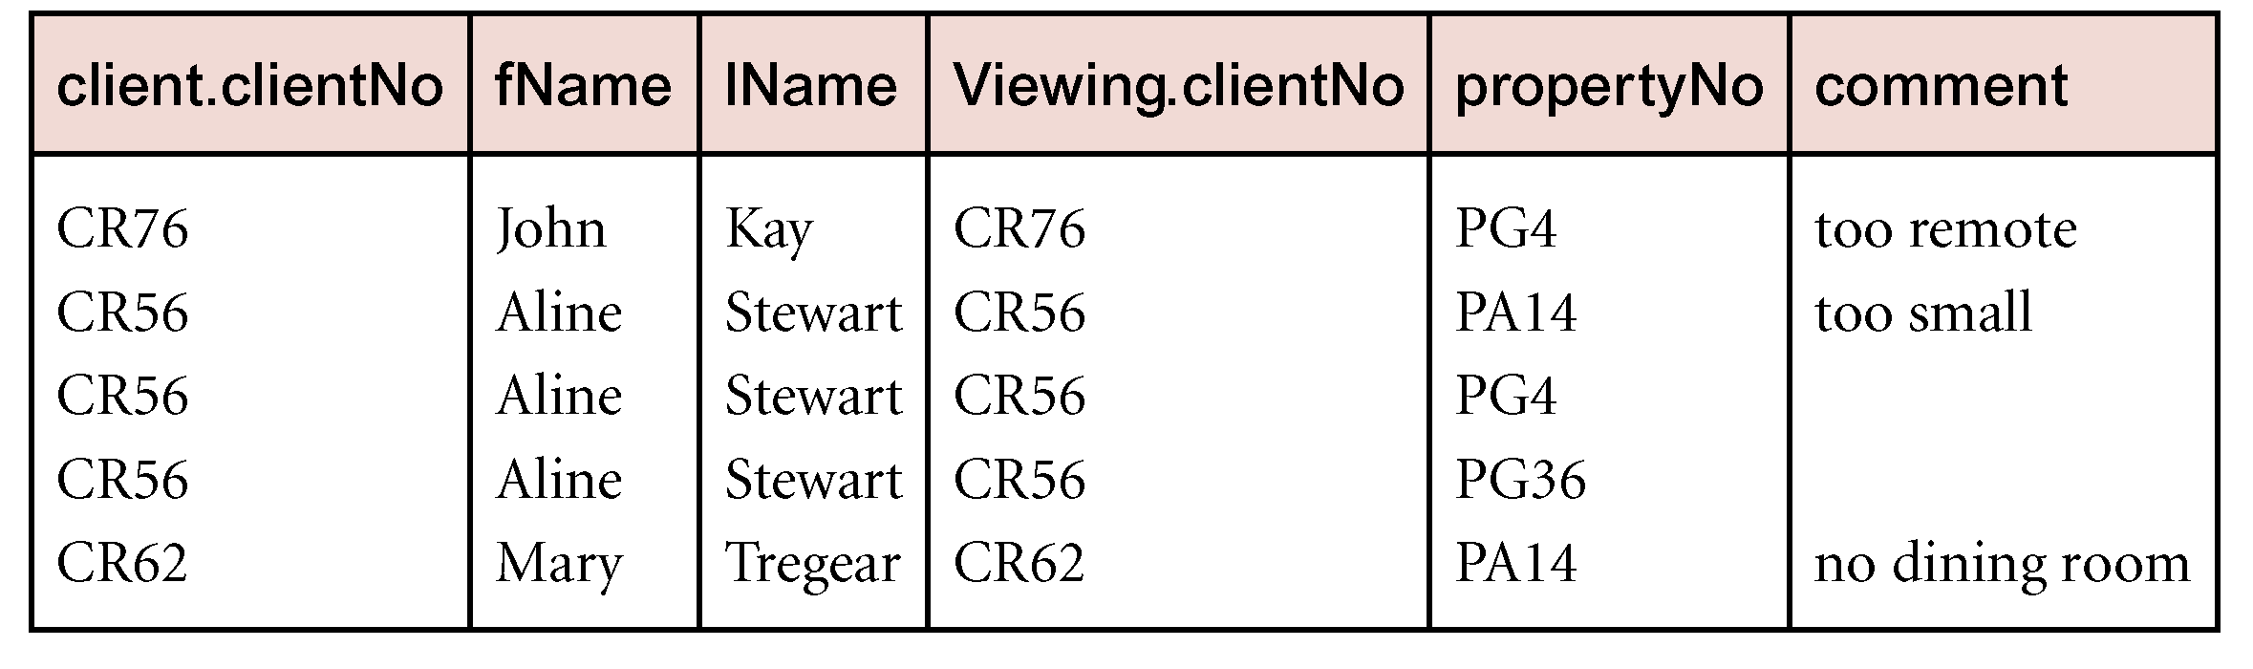
Example - Equijoin
List the names and comments of all clients who have viewed a property for rent.
(Π_{clientNo, fName, lName}(Client)) Client.clientNo = Viewing.clientNo (Π_{clientNo, propertyNo, comment}(Viewing))

Slide 52
Natural join
R S
An Equijoin of the two relations R and S over all common attributes x. One occurrence of each common attribute is eliminated from the result.

Slide 53
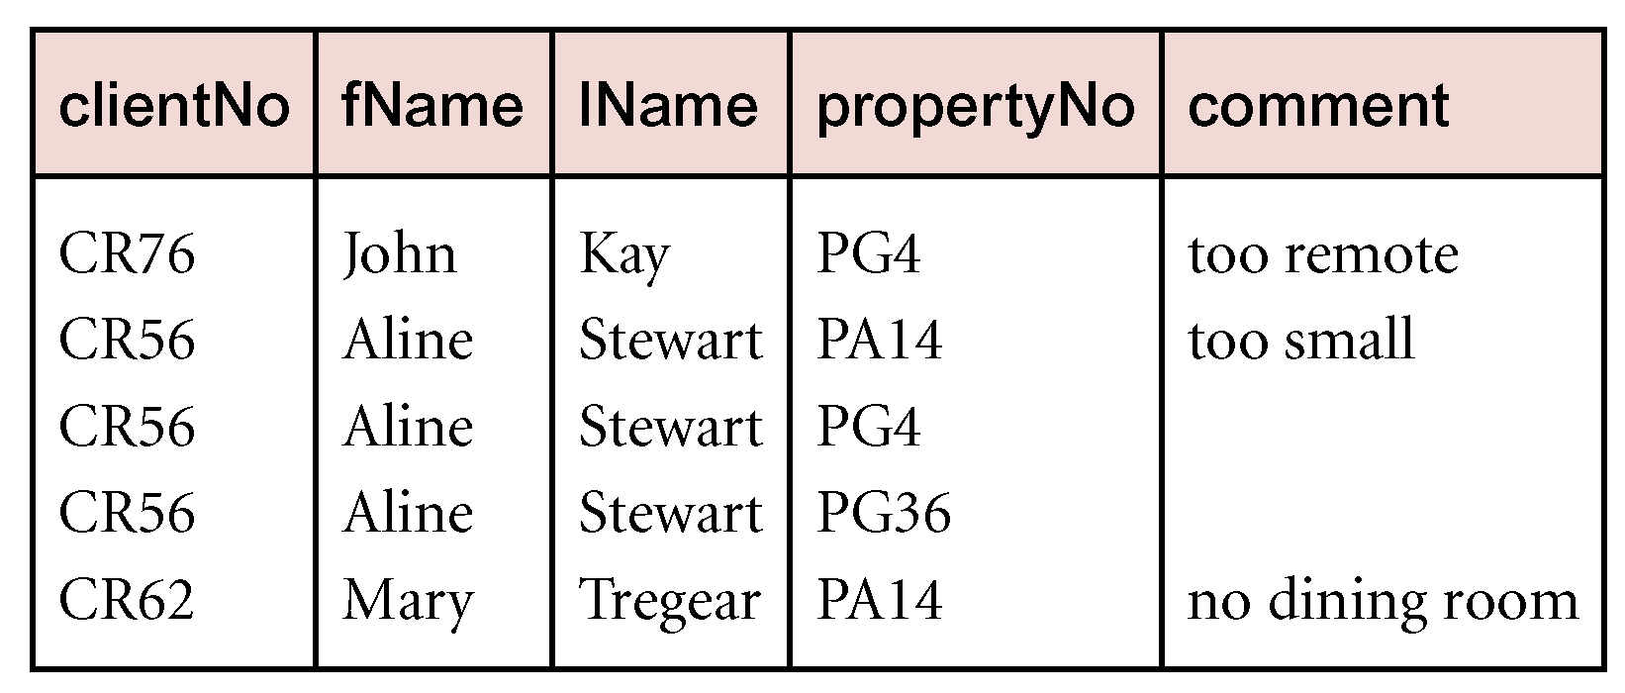
Example - Natural join
List the names and comments of all clients who have viewed a property for rent.
(Π_{clientNo, fName, lName}(Client))
(Π_{clientNo, propertyNo, comment}(Viewing))

Slide 54
Outer join
To display rows in the result that do not have matching values in the join column, use Outer join.
R S
Outer join may retain the tuples which would be lost by natural join
Left outer join of R and S retains all of R
Right outer join of R and S retains all of S

Slide 55
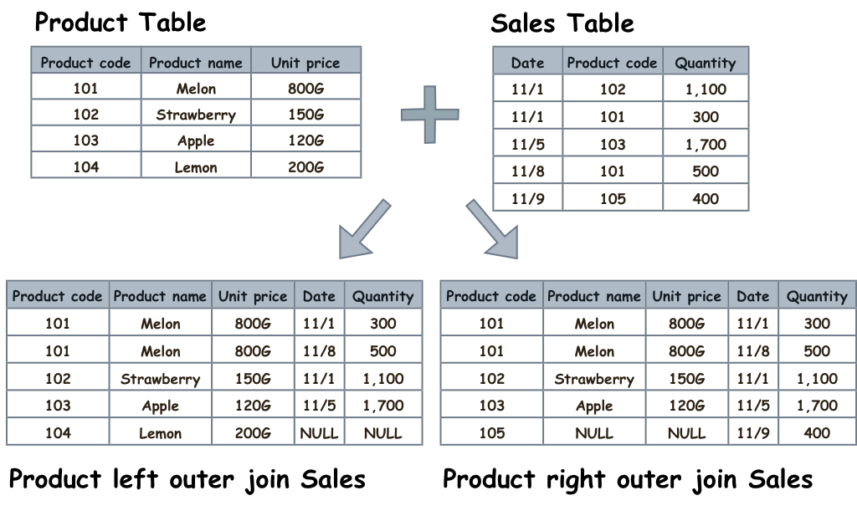
Outer join Example

Slide 56
Example - Left Outer join

Slide 57
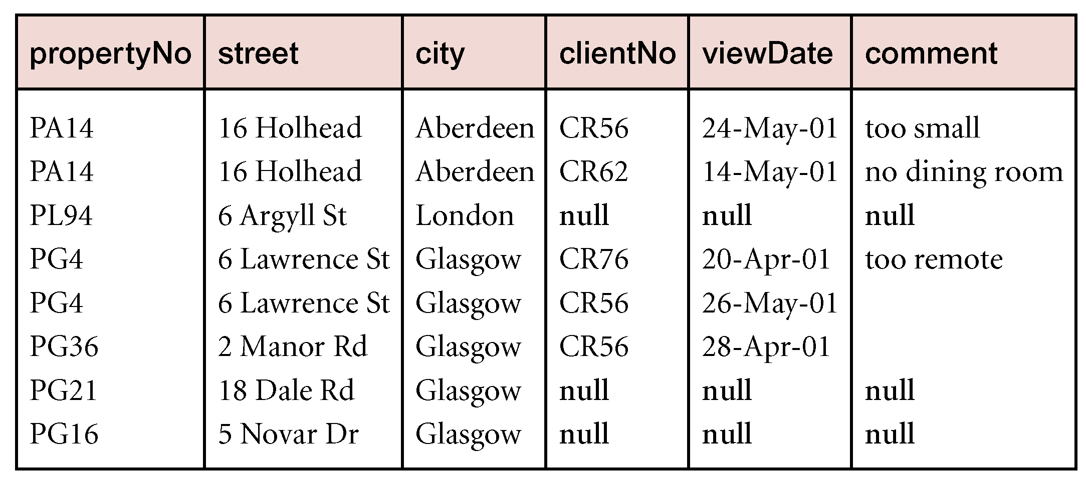
Example - Left Outer join
Produce a status report on property viewings.
Π_{propertyNo, street, city}(PropertyForRent)
Viewing

Slide 58
Semijoin
R _{F} S
Defines a relation that contains the tuples of R that participate in the join of R with S.
Can rewrite Semijoin using Projection and Join:
R _{F} S = Π_{A}(R _{F} S)

Slide 59
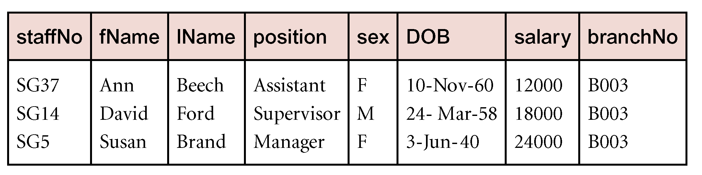
Example - Semijoin
List complete details of all staff who work at the branch in Glasgow.
Staff _{Staff.branchNo=Branch.branchNo}(σ_{city=‘Glasgow’}(Branch))

Slide 60
Division
R ÷ S
Defines a relation over the attributes C that consists of set of tuples from R that match combination of every tuple in S.
Extracts rows whose column values match those in the second table, but only returns columns that don’t exist in the second table.

Slide 61
Example - Division

Slide 62
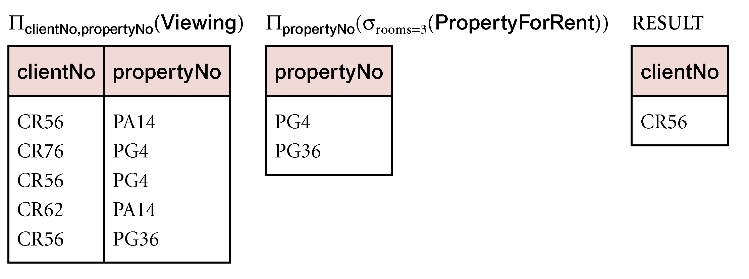
Example - Division
Identify all clients who have viewed all properties with three rooms.
(Π_{clientNo, propertyNo}(Viewing)) ÷
(Π_{propertyNo}(σ_{rooms = 3} (PropertyForRent)))

